Slide 1

Bradley Catalyst Grant Program
Lynde and Harry Bradley Foundation
Board of Directors Meeting
August 16, 2010

Slide 2
Economic Development
Economic Development
Talent
Ideas
Capital
UWM – A source for ideas and talent that drive economic development

Slide 3
Catalyst Grant Program
Program Design
Strong Science
Commercial Potential
Catalyst Grants
Measuring Success
Student Thesis
Publication
Follow On Funding
Recognition
Research & Scholarship
UWMRF Res. Fellowship
Grant App.
Discl.
Prov.
Util, App.
Patent
Materials Evaluation
Intellectual Property
Partner Meetings
Marketing Campaign
Prototype Device
Corp. Spons. Res.
Corp. Partner
Startup Launch
License
$
Investor Meeting
SBIR Grant
Startup
Business Plan
Option Agmt.
SBIR App.

Slide 4

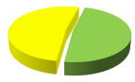
Bradley Catalyst Phases
FY 08
FY 09
FY 10
FY 11
32 Projects Proposed
15 New Inventions
Phase 1
$500k Invested
7 Funded Projects
27 Projects Proposed
18 New Inventions
Phase 2
$500k Invested
7 Funded Projects
27 Projects Proposed
18 New Inventions
Nearly ½ of recent proposals were from faculty who joined UWM in the last year
Phase 3
$400k Invested
8 Funded Projects

Slide 5
Catalyst Outcomes
Funds Awarded:
$2,045,000 awarded to date with support from Bradley, Rockwell and Herzfeld
Research and Scholarship:
33 scholarly articles published and four more being prepared
$1.2 million in follow-on funds for catalyst projects – from sources including the National Science Foundation (NSF) and the National Institutes of Health (NIH)
6 student theses supported under catalyst projects
Intellectual Property:
51 new inventions disclosed as a direct result of the Bradley catalyst program
13 patent applications related to catalyst grants
Two patents issued to researchers funded by catalyst grants
Corporate Partnering and Startups:
Two license agreements completed with biomedical startup company, Addiction Therapeutics and UWM professor Junhong Chen’s startup company, NanoAffix
Two sponsor option agreements completed with international biotechnology company and Milwaukee-based water industry company, Advanced Chemical Systems
Equity ownership in UWM startup company
Two startup business plans related to catalyst projects
Five SBIR Grant Applications related to catalyst funded technologies
Catalyst Grant Program Outcomes
Funds Awarded:
$2,045,000 awarded to date with support from Bradley, Rockwell and Herzfeld
Research and Scholarship:
33 scholarly articles published and four more being prepared
$1.2 million in follow-on funds for catalyst projects – from sources including the National Science Foundation (NSF) and the National Institutes of Health (NIH)
6 student theses supported under catalyst projects
Intellectual Property:
51 new inventions disclosed as a direct result of the Bradley catalyst program
13 patent applications related to catalyst grants
Two patents issued to researchers funded by catalyst grants
Corporate Partnering and Startups:
Two license agreements completed with biomedical startup company, Addiction Therapeutics and UWM professor Junhong Chen’s startup company, NanoAffix
Two sponsor option agreements completed with international biotechnology company and Milwaukee-based water industry company, Advanced Chemical Systems
Equity ownership in UWM startup company
Two startup business plans related to catalyst projects
Five SBIR Grant Applications related to catalyst funded technologies

Slide 6
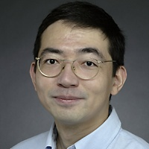
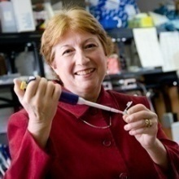
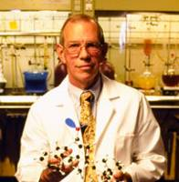
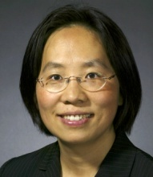
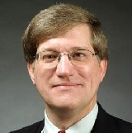
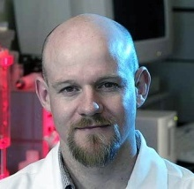
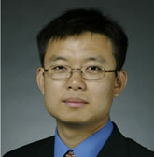
Catalyst Grants: Bradley Phase 1
FY 08
FY 09
FY 10
FY 11
Jian Chen
Adv. Materials
UWMRF Res. Fellowship
Pub
Student Thesis
Mary Lynne Collins
Protein Expression System
Bio Co Option
Market Campaign (44 Co’s)
Materials Evaluations
(2 Co’s)
Key Prospect
Spons Res Agmt
Related patents and application
James Cook
Novel Compounds
MPP License
SBIR App.
NIH Grant:
Publications (9)
Key Outcome
Sarah Gong
Adv. Polymers/Mat’ls
Related patent applications
Prov. Patent
NSF Grant:
Publications
Dave Klemer
Bio sensors
SBIR App.
CTSI Grant:
Graham Moran
Anti-bacterial use
Publications
Prov. Patent
Market Campaign
Util. Patent App’
Hao Zhang
Retinal imaging
Key Outcome
Prototype Instrument
Shaw Scientist Award
JDRF Funding
Util. Patent App’s (4)
Business Plan
Pub’s
Angel Inv. / Entrepreneur meetings

Slide 7
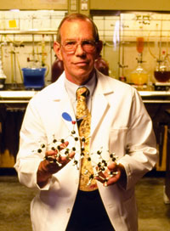

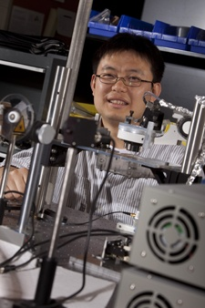


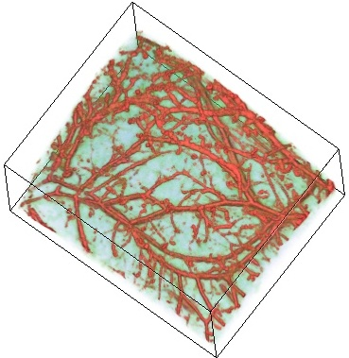
Catalyst Grants: Bradley Phase 1
James Cook
Novel Compounds for Treatment of Alcohol Addiction
License to MPP Group – local biotech startup company
MPP Group: SBIR grant application & grant from Wisconsin Dept. of Commerce
Two related patent applications
Multiple peer-reviewed papers
Additional funding from NIH
Bradley Phase 1
Hao Zhang
Retinal Imaging System
Built prototype device to demonstrate retinal imaging system in mouse model
Follow on funding from Juvenile Diabetes Association
Joint agreement with USC to protect and market technology
Four U.S. patent applications
Shaw Scientist Award Winner
Investor presentations & meetings
Bradley Phase 1

Slide 8
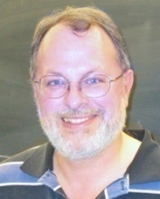
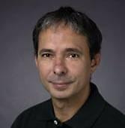
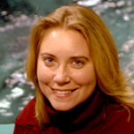
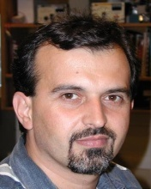
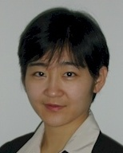
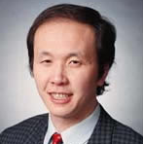

Catalyst Grants: Bradley Phase 2
FY 09
FY 10
FY 11
Peter Geissinger
Fiber optic sensing
Key Outcome
Adv. Chem. Sys. Option
Adv. Chem. Sys.
Related
patent
Gil Indig
Pigments & Surfaces
Prov. Pat. App.
Key Prospect
$
Angel Invest.Mtgs
Marketing Campaign
First Look Pres.
Materials Evaluations
(4 in work).
Rebecca Klaper
Nano toxicity
EcoArray
Corp Part. Mtgs
SBIR Opportunity
Vali Raicu
Microscopy Inst.
Standstill agreement
Key Prospect
FastTrac Tec
Bus. Plan
Angel Inv. / Entrepreneur meetings
$
Lei Ying
MRI algorithms
Related patent app
GE
Prov.
Marketing Campaign
Related patent applications (3)
Jun Zhang
Patient informatics
Aurora
Joseph Bockhorst
Wind prediction
We Energies

Slide 9
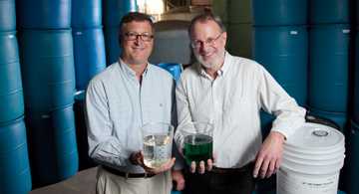
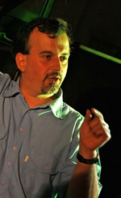
Catalyst Grants: Bradley Phase 2
Peter Geissinger
Fiber Optic Sensing for Industrial Water Applications
Partnership and option agreement with Advanced Chemical Systems
ACS is developing business plan and exploring SBIR grants to further develop technology
Bradley Phase 2
Vali Raicu
Microscope for Protein Studies
Developed business plan with UWMRF and BizStarts Venture Track
UWMRF First Look investor forum and other investor presentations
Startup company formation and funding in process
U.S. patent application
Bradley Phase 2

Slide 10
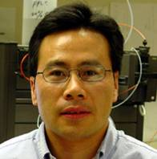

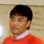


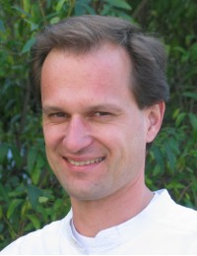
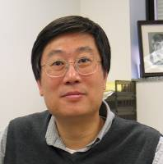
Catalyst Grants: Bradley Phase 3
FY 10
FY 11
Joe Bockhorst
Liver Pathology Software
Yi-Qiang Chen
Anti-Cancer Compounds
Key Prospect
Lian Li
Memory Storage Device
Related patent applications (2)
Ying Li
Carbon Capture
Ethan Munson
Software Devel. Tools
Michael Nosonovsky
Anti-fouling Coatings
Jorg Woehl
Genetic Profiling Inst.
Related Prov.
application
Ching-Hong Yang
Innovative Antibiotics
Key Prospect
Related patent applications (2)

Slide 11
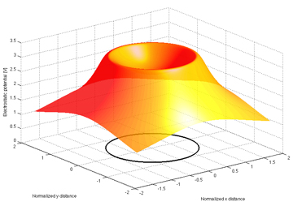
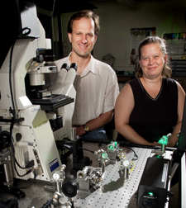
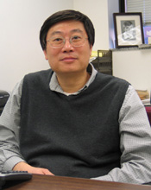
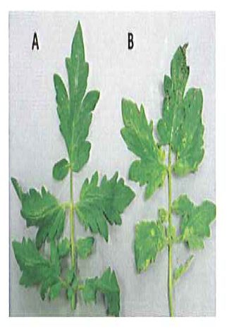
Catalyst Grants: Bradley Phase 3
Jorg Woehl
Instrument for Genetic Profiling
Bradley Phase 3
A potentially transformational technology to enable a new method of genetic profiling
Technology creates an electric field to trap charged particles – may ultimately be able to distinguish variations in genetic sequences
Ching-Hong Yang
Innovative Antibiotics
Developing antibiotics that attack the virulence of pathogens without killing them – reducing the tendency to develop antibiotic resistance
Applications in plants moving forward – future potential applications in human and veterinary applications
Bradley Phase 3

Slide 12
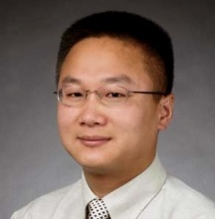
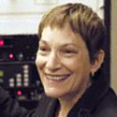
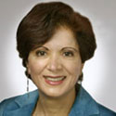
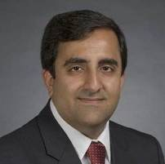
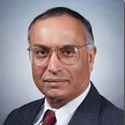
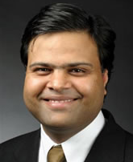
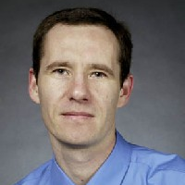
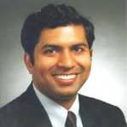
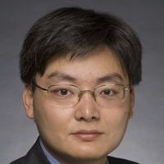
Catalyst Grants: Rockwell
FY 07
FY 08
FY 09
FY 10
FY 11
SWETRC Grant
Lithium ion batter app’s
Follow-on Catalyst with Energy Center
NSF Grant: $300k
NSF Grant: $263
Related Pubs (4)
Key
Outcome
Phase 1
Junhong Chen
Nanotube decoration
Prov & Util., 8/09
Journal Cover/Pub, 7/09
NanoAffix Formation, SBIR apps (3), License
Carolyn Aita
Nano-laminates
Thesis Support (4)
Pubs (8) + Conf Proc.
Fatemeh Zahedi
Enterprise Informatics
Corp. Partner
Pubs in Prep
Phase 2
Arash Mafi
High bandwidth fiber
Corning
Prov.
Submitted Pubs
Pradeep Rohatgi
Adv. castings/mat’ls
Student Thesis
Mukul Goyal
Adv. routing software
Publications
Phase 3
Nikolai Kouklin
Nano water sensor
Krishna Pillai
POREFLOW software
Marketing Campaign
Zhen He
Bio fuel cells & desal’
Discl.
Partner - Research
Prov. Patent
Key
Prospect
UWMRF Res. Fellowship
$
Investor Meeting

Slide 13
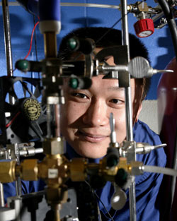
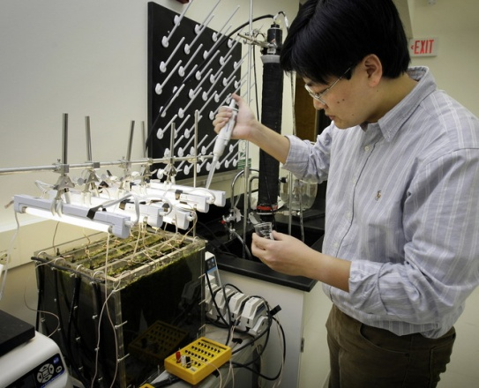
Catalyst Grants: Rockwell
Junhong Chen
Nanotube Decoration
License completed with Dr. Chen’s startup company, NanoAffix Technologies
Over $500k in follow on funding from the National Science Foundation
Multiple U.S. patent applications based technology and applications
Rockwell Phase 1
Zhen He
Biological Fuel Cells for Energy Production
Working to scale up technology that creates energy from wastewater
Other applications in desalination
New faculty member already establishing strong industry partnerships
Rockwell Phase 3

Slide 14
Development Continuum
Ideas
Catalyst Grants
Gap Fund
Market
Catalyst Grants:
Review by leading scientists
Proof of concept
Potential intellectual property
Proposal: specific aims and commercial potential
Gap Fund Awards:
Review by industry and investors
Prototype
Existing intellectual property
Proposal: business case

Slide 15
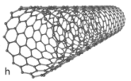
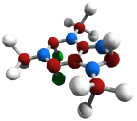
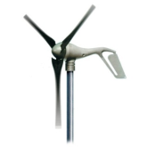
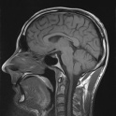
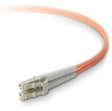
Intellectual Property Portfolio
Bio Science/Chemistry
Materials & Devices
Licensed Technologies: 2
Issued Patents: 3
U.S. Applications: 10
Intl’ Applications: 4
Related Catalyst Grants: 4
Licensed Technologies: 1
Issued Patents: 1
U.S. Applications: 4
Related Catalyst Grants: 5
Imaging/Instruments
Energy Technology
Allowed Patents: 1
U.S. Applications: 12
Intl’ Applications: 2
Related Catalyst Grants: 4
U.S. Applications: 3
Intl’ Applications: 1
Communications
Allowed Patents: 1
U.S. Applications: 1
Related Catalyst Grants: 2
Water/Aquaculture
Licensed Technologies: 1
Optioned Technologies: 1
Issued Patents: 1
U.S. Applications: 2
Related Catalyst Grants: 2
Software/Copyrights
Copyright Matters: 4
Related Catalyst Grants: 2
Intellectual property investments are strategically linked to catalyst grants

Slide 16


Slide 17

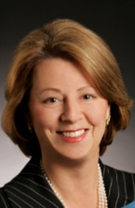
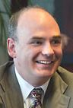

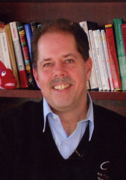
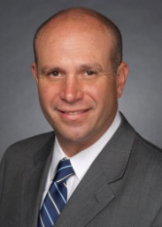


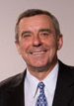
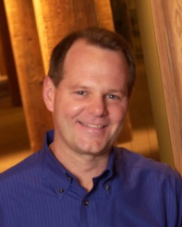

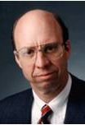
UWM Foundations
UWM Research Foundation Board
Jacquelyn Fredrick
President and CEO
Blood Center of Wisconsin
Chair, UWM Research Foundation
Daniel J. Bader
President, Helen Bader Foundation
Vice Chair
UWM Research Foundation
William Berezowitz
Vice President and General Manager
Imaging Subsystems
GE Healthcare
Trevor D’Souza
Director
Mason Wells
David Gilbert
President
UWM Foundation
Sujeet Chand
Sr. Vice President and Chief Technical Officer
Rockwell Automation
Andrew Schiesl
Vice President, General Counsel and Corporate Secretary
Quad/Graphics
Michael Major
President and CEO
Cambridge Major Laboratories
Gregory Uhen
Director, UWM Research Foundation
President, Eppstein Uhen: Architects
Colin Scanes
Vice Chancellor for Research and Economic Development and Dean of the Graduate School, UWM
John Torinus
Chairman
Serigraph Corporation

Slide 18


Financing UWMRF Operations
Operating Cash Inflows
Firm/Projected Commits
Operating Cash Outflows
Projected Need
Operating Cash Surplus/Fund Raising Gap
Operating Cash Surplus
Operating Cash Fund Raising Target

Slide 19

Intellectual Property Development
Invention Disclosure
150
100
50
FY:
2007
2008
2009
2010
Patent Matters
Prosecution
9
12
Utility App.
7
Prov. App.
4
6
9
10
6
6
10
FY:
2007
2008
2009
2010

Slide 20
Targeting Strategic Clusters
GE Healthcare
Biomedical
Engineering
Cambridge Majors Labs
Sigma Aldrich
Froedtert
PhysioGenix
MPP Group
Promentis
Advanced Manufacturing
Healthcare
Children’s
Hospital
MCW
UWM Funded Research Strengths
Rockwell
Cerner
BloodCenter
Harley Davidson
Johnson
Controls
Aurora Health Care
School of Public Health*
Nursing
Synthesis &
Drug Disc.
Innovation Park*
Computation
Eaton
Healthcare
Informatics
Neuro. Sci.
Astronautics
Biological Sciences
Imaging
Quad Graphics
City of Milwaukee Health Dept.
Health Science
Info. Sci.
Sensors & Devices
Energy
Environment
Atmo. Sci.
Red Prairie
Materials
Structures
Generac
Water
Computer Sci.
We
Energies
ReGENco
School of Freshwater Science*
Water/Energy/ Environment
M7/Water Council
Siemens
MMSD
Veolia
Baker Mfg.
Pentair
ITT
ASA Analytics
A.O. Smith
Advanced Chemical Systems
Kohler
Badger
CH2MHill

